Slide 1
Phambili.com

Slide 2
Phambili.com
Tushar Naik – Engen Petroleum
John Diedericks - Shoprite
Anita Carollisen - TFG
Maria Sithole – Pick n Pay
Seelan Naidoo – Smollan Group
Sanjay Dubru – Jhb Market

Slide 3
“Time Of The Millennials”

Slide 5
Quiz Time
Innovation is considered to be one of the top three ‘purposes’ of business and just as important as profit
Millennial believe that the best Sectors to work in are Retail, Manufacturing & Farming so that they can make an impact to Environmental sustainability
87% believe the success of a business should be measured by more than just financial performance
FOMO means the Fear Of Meeting Others
Zomato is a genetically modified tomato

Slide 6
Quiz Answer Time
Innovation is considered to be one of the top three ‘purposes’ of business and just as important as profit - TRUE
Millennial believe that the best Sectors to work in are Retail, Manufacturing & Farming so that they can make an impact to Environmental sustainability - FALSE
87% believe the success of a business should be measured by more than just financial performance - TRUE
FOMO means the Fear Of Meeting Others - FALSE
Zomato is a genetically modified tomato - FALSE

Slide 7
Population Spread of South Africa

Slide 8
Stats SA

Slide 9
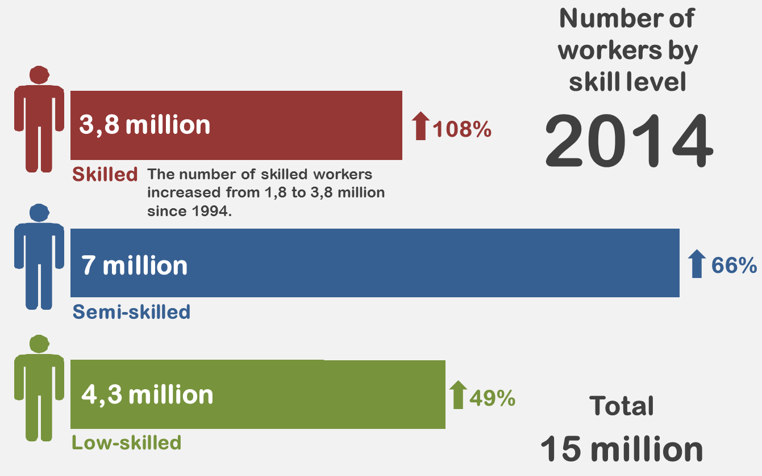
Stats SA

Slide 10
Why is this important?
World of Work Conference

Slide 11
Situation
The retail sector is the fourth largest contributor to the GDP (15%).
Decrease in GDP contribution
Current retail workforce at 22%
Decrease in skills gap
Stats SA – 2014 Census

Slide 12
Concerns
The Wholesale and Retail sector is not attractive as an employer of choice to talented millennials who will otherwise be captured by other sectors.

Slide 13
Concerns - Implications
Should these concerns not be addressed we won’t get the most talented, connected, passionate, creative and innovative workforce that aspire to be in Wholesale and Retail, which results in mediocre performances, poor shopper experiences, and therefore a decrease in the GDP contribution by the sector.

Slide 14
Concerns - Worries
Decrease in GDP contribution ultimately means loss of sales in the sector.
Continued misconception of the roles within Wholesale and Retail by talented millennials.

Slide 15
Question
How do we make the South African Wholesale and Retail sector attractive to young talented millennials?

Slide 16
Answers
Provide Structure
Work-Life balance
Showcasing Innovation
Flexibility in work hours
Leaders & Business with Purpose

Slide 17
Business and Leaders with purpose, Creating Shared Value Model in Wholesale and Retail
Central core of creating shared value:
Organisations going beyond corporate social responsibility and ensuring involvement.
Creating value to society and engaging its employees, the business, shareholders and society as a whole
Who does this?
H&M (Garment Collection Initiative)
Coca Cola Ghana (#5by20 Project)

Slide 18
Reasoning:
Garment Collection Initiative

Slide 19
Ghana Coca-Cola #5by20

Slide 20
Reasoning
Research conducted:
Results of Climate surveys (TFG, Smollen Group)
Review of exit interviews (Shoprite & Pick n Pay)
Meetings with Deloitte, EY & MasterCard
Meetings with Coca Cola and Ruben Atekpe
Meetings with various Leaders in Industry
LEADERSHIP WITH PURPOSE
ORGANISATIONS WHO LOOK BEYOND PROFITS

Slide 21
Reasoning – Informal discussions with millennials & Internet research completed
“My choices are more calculated, deliberate, meaningful and researched”
“I have Real time access to information, and I'm willing to share widely with my network”
“I’m insecure about today, but optimistic about the future”
“I want to make a difference”
“My life is an adventure”
“I don’t just want to be a number, I want to be part of an organizational movement”

Slide 22
Evaluation
SHARED VALUE MODEL
Further in depth analysis and formalised surveys to be conducted with South African millennials in Wholesale and Retail
Further research to be conducted on Organisational Learning environment amongst all generations

Slide 23
Action Plan
Evaluate CSI Programs
Evaluate Involvement of employees (specifically Millennials)
Review relevance and resonance with Millennials and Organisations CSI strategy
Set up Shared Value Forums
Set KPI’s
Meet monthly
Drive Projects
Initiate new projects
Report of performance and impact to all stakeholders
Examples:
Coca Cola 2050 Project
H&M
TFG
The Clothing Bank

Slide 24
Schweet…

Slide 25
Actually Not…
#sorrynotsorry

Slide 26
“Niyabasaba na?”
Haai, asibasabi, SIYABAFUNA
“Are you afraid of them?
No, we want to face them!

Slide 27
Ok for reals Schweet…

